Slide 1
WELCOME TO ALL IN RRM OF JUNE-22

Slide 2
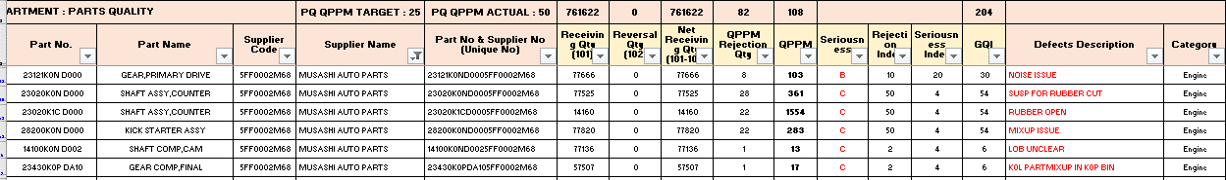
GQI-Information by Customer
As on date 02.07.2022
As on date 06.07.2022
After negotiation register claims are 2 (6) and GQI 36 (204)

Slide 3
CUSTOMER CLAIM AND GQI PERFORMANCE
1. Customer GQI Detail:
 | Index | Unit |  | 1st half | 2nd half | 2021-22 (Avg) | APR-22 | MAY-22 | JUN-22 | JULY-22 | AUG-22 | SEP-22 | OCT-22 | NOV-22 | DEC-22 | JAN-23 | FEB-23 | MAR-23
 |  |  |  | PLAN | PLAN
I-1 | Musashi Performance GQI | …. | P | 7.6 | 5.3 | 7 | 0 | 0 | 0 | 14 | 14 | 0 | 0 | 22 | 0 | 14 | 0 | 0
 |  |  | A | 28.66 | 51.66 | 40 | 88 | 44 | 36
 |  |  | Judge | 1st half | 2nd half | X | X | X | X
2.No of Customer Claim Detail:
 | Index | Unit | 1st half | 2nd half |  | 2021-22 (Avg) | APR-22 | MAY-22 | JUN 22 | JULY-22 | AUG-22 | SEP-22 | OCT-22 | NOV-22 | DEC-22 | JAN-23 | FEB-23 | MAR-23
 |  |  | PLAN | PLAN
I-1 | Customer Claims (Un Reg + Reg ) | Un Reg | 1.82 | 2.16 | P | 2 | 0 | 2 | 2 | 2 | 3 | 3 | 3 | 3 | 3 | 2 | 2 | 2
 |  |  |  |  | A | 3.5 | 5 | 4 | 8
 |  | Reg. | 0.83 | 0.66 | P | 0.75 | 0 | 0 | 0 | 1 | 1 | 0 | 0 | 1 | 0 | 1 | 0 | 0
 |  |  |  |  | A | 1.90 | 4 | 2 | 2
 |  |  |  |  | Judge | X | X | X | X
Register Claim
Non Register Claim
Non Register Claim
IN THE MONTH OF JUN-22 REG CLAIMS 2 & 8 UNREG CLAIMS

Slide 4
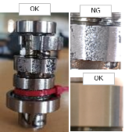
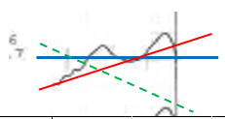
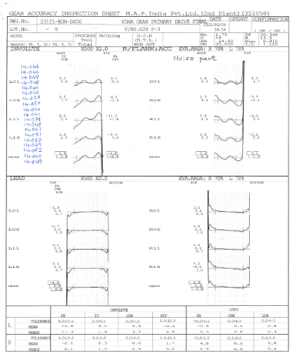
CUSTOMER CLAIM SUMMARY & REGISTER CLAIMS ACTIONS
Sr. No | DATE | Classification | CUSTMER | RESPONSE | RPT | SECTION | Out Flow SEC | MODEL | MATTER | QTY | NPD | Report Status | RANK | GQI | Rgt GQI
1 | 01.06.2022 | Register | HMSI-3F | MAP ID | 0 | CAM LINE | Q GATE | K0NA | LOBE UNCLEAR (01no) | 1 | 0 | X | C | 6 | 6
2 | 08.06.2022 | Non Register | HMSI-3F | MAP ID | 0 | CAM LINE | Assy | K0NA | Shaft Comp Cam After assy in enging (Bearing Rotation Hard) | 1 | 0 | X | C | 6
3 | 09.06.2022 | Register | HMSI-3F | MAP ID | 0 | Gear B | Q GATE | K0NA | Abnormal Noise due to GPD Lead Profile NG | 9 | 0 | X | B | 30 | 30
4 | 09.06.2022 | Non Register | HMSI-3F | MAP ID | 0 | Assy | Assy | K0NA | Shaft assy Counter Rubber Band Cut | 12 | 0 | X | C | 54
5 | 21.06.2022 | Non Register | HMSI-3F | MAP ID | 0 | Hard Line | Hard Line | K0PG | Gear Comp Final Model Mix up (K0LA part Found in K0PG Bin) | 1 | 0 | X | C | 6
6 | 21.06.2022 | Non Register | HMSI-3F | MAP ID | 0 | RQA/Assy | RQA/Assy | K0NA | SKS Spring Kick Return Open end Profile NG | 1 | 0 | X | C | 6
7 | 25.06.2022 | Non Register | HMSI-3F | MAP ID | 0 | RQA/Assy | RQA/Assy | K0NA | SKS Spring Kick Return Top Washer Pullout | 1 | 0 | X | C | 6
8 | 28.06.2022 | Non Register | HMSI-3F | MAP ID | 0 | Assy | Assy | K0NA | SKS Spring Kick Return stapler pin between gear & top Washer | 1 | 0 | X | C | 6
9 | 29.06.2022 | Non Register | HMSI-3F | MAP ID | 0 | Hard Line | Hard Line | K0PG | Shaft drive Dia 10mm Tight Entry due to Damage | 2 | 0 | X | C | 14
10 | 30.06.2022 | Non Register | HMSI-3F | MAP ID | 0 | RQA/Assy | Q GATE | K0PG | Shaft comp Cam Decomp Movement not smooth. | 3 | 0 | X | C | 14
Red Front- Register Claim |  |  |  | Customer Dropped |  |  |  |  |  | Grand Total |  | Issue | 10 | 148 | 36
Action Summary
Sl No. | DATE | Model & Part | ISSUE | Defect Photos | Rej QTY | SECTION | CAUSE | Actions | Action Implantation Status | Report Status | Action Judgement | HD Applicable areas | HD Status
1 | 01.06.22 | 14100-K0NA-E000 Shaft Comp Cam | Lobe Unclear on Ex Lobe |  | 1 | Cam Line & Q Gate | Occurrence Drawing not handover from ME and Spare not arranged Outflow Constant speed not maintained at the time of Inspection | Occurrence 1.Immediate: Spare arranged and replaced 2.Permanent:Checkpoint added in TPM 3.Constitution: PCJS Check sheet modified with section head verification Outflow 1. Training and awareness given for better understanding part inspection 2. Weekly CCTV monitoring of inspector inspection time for constant time and method. 3. Weekly poison test for repeated customer complaint. | Completed | Under Review | Actions are Under Monitoring | Other Models | ∆
2 | 09.06.22 | 23121-K0N-D000 GPD | Noise due to Profile NG |  | 9 | Gear B | Occurrence Rule weakness to address the part preservation in specific Outflow NA- No 100 % inspection for Lead and Profile | Occurrence SOP to be amended including the Part flow and preservation of NG parts with responsible members Outflow NA- Need to be controlled with Occurrence Action only | Completed | Under Review | Actions are Under Monitoring | Other Models K1CA | ∆

Slide 5
CUSTOMER CLAIM ACTIONS-UN REGISTER CLAIM
Sr. No | DATE | CUSTMER | SECTION | MODEL | MATTER | QTY | Remarks.
1 | 08.06.22 | HMSI-3F | CAM LINE/Assy | K0NA | Shaft Comp Cam After ASSY in engine (Bearing Rotation Hard) | 1 | Suspected parameters checked and informed to customer.
2 | 09.06. 22 | HMSI-3F | Assy | K0NA | Shaft ASSY Counter Rubber Band Cut | 12 | 1.Rubber bend supplier change based on customer feedback. 2. Stop applying antirust oil after rubber bend on parts.
3 | 21.06.22 | HMSI-3F | Hard Line | K0PG | Gear Comp Final Model Mix up (K0LA part Found in K0PG Bin) | 1 | Based on Our controls, customer has requested for further possibility study
4 | 21.06.22 | HMSI-3F | RQA/Assy | K0NA | SKS Spring Kick Return Open end Profile NG | 1 | Shared the inspection report and found the parameters are as per drawing.
5 | 25.06.22 | HMSI-3F | RQA/Assy | K0NA | SKS Spring Kick Return Top Washer Pullout | 1 | Justified by Shaft and washer inspection report(both parts found as per drawing)
6 | 28.06. 22 | HMSI-3F | Assy | K0NA | SKS Spring Kick Return stapler pin between gear & top Washer | 1 | Parts clear and instruction given for the visual before dispatched.
7 | 29.06.22 | HMSI-3F | Hard Line | K0PG | Shaft drive Dia 10mm Tight Entry due to Damage | 2 | While Removing from noise vehicle parts found damage.
8 | 30.06.22 | HMSI-3F | RQA/Assy/Q Gate | K0PG | Shaft comp Cam Decomp Movement not smooth. | 3 | Observed hard movement due to spring decomp tension, found as per drawing specification.
Immediate actions has taken to stop outflow wherever applicable.

Slide 6
CLAIMS & GQI THE MONTH OF
JUNE-2022
Date :- 12.07.22

Slide 7
RRM
THE MONTH OF JUNE-22
IN-PROCESS REJECTION DETAILS
Date :- 12.07.22

Slide 8
Ⅰ-1-1-3 : CRITICAL PROCESS/PARAMETERS HAS BEEN IDENTIFIED & CROSS-VERIFICATION TO BE DONE DAILY BY PATROLLING & PROCESS AUDIT IN ALL SHIFTS TO REJECTION REDUCTION.
2022-2023 |  |  |  |  |  |  | IN-HOUSE REJECTION % RESULTS MONITORING
 | Index | Dept. | Unit | 1st half | 2nd half |  | Apr-22 | May-22 | Jun-22 | Jul-22 | Aug-22 | Sep-22 | Oct-22 | Nov-22 | Dec-22 | Jan-23 | Feb-23 | Mar-23
 |  |  |  | PLAN | PLAN
I-1 | Rejection Ratio | QA | REJ % | 0.20 | 0.14 | P | 0.24 | 0.24 | 0.24 | 0.21 | 0.21 | 0.21 | 0.18 | 0.18 | 0.18 | 0.16 | 0.16 | 0.16
 |  |  |  |  |  | A | 1.28 | 1.50 | 1.91
 |  |  |  |  |  | RESULT | Ï | Ï | Ï
IN JUNE-22 MONTH REJECTION TARGET NOT ACHIVED ,DUE TO GPD TCE MORE ,GPDN KONA TCE MORE & CD MORE ISSUE AND CAM K0NA DECOMP HEIGHT NG, . MAJOR REJECTION CONTRIBUTING SECTION IN OVERALL REJECTION IS ,CAM SHAFT LINE ,GEAR-A & GEAR B LINE.

Slide 9


SECTION WISE REJECTION COST PLAN VS ACTUAL TRENDS OF 2022-2023
TOP 3 MAJOR REJECTION CONTRIBUTING SECTION IS CAM LINE ,GEAR-A & GEAR-B

Slide 10
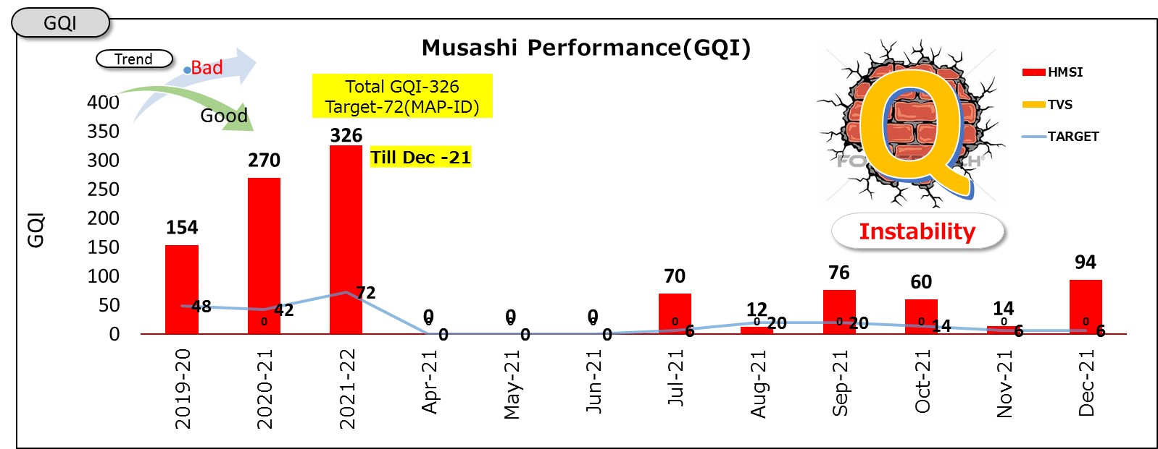
REJ % SECTION WISE & TOP 10 PARTS CONTRIBUTION ON JUNE-22
THESE ARE THE TOP 10 PARTS HAS MAJOR CONTRIBUTION IN OVERALL IN-HOUSE REJECTION.

Slide 11
LINE WISE REJECTION CONTRIBUTION IN JUNE-22
GEAR-B, CAM SHAFT & GEAR-A LINE ARE MAJOR REJECTION QTY CONTRIBUTOR IN OVERALL REJECTION
HONDA CONTRIBUTION IS 89 % AND TVS HAS 11 % IN OVERALL REJECTION .

Slide 12
MAP BLR CAM LINE REJECTION PARETO JUNE-22
CAM K0NA/K0PA/K1CA DECOM HIGHT NG & CAM ANGLE NG IS MAJOR REJECTION CONTRIBUTOR FROM CAM LINE.

Slide 13
MAP BLR GEAR B LINE REJECTION PARETO JUNE-22
GPD K0NA, M3 K0NA, & C5 K0NA ARE THE TOP 3 MAJOR REJECTION IN GEAR-B.

Slide 14
MAP BLR GEAR A LINE REJECTION PARETO JUNE-22
GPDN K0NA, GEAR COUNTER K0PA & GEAR FINAL K0PG ARE THE TOP 3 CONTRIBUTOR IN GEAR-A

Slide 15
MAP BLR HARD LINE REJECTION PARETO JUNE-22
SHAFT DRIVE K0PG,SHAFT COUNTER K0PA & SHAFT MAIN K0NA ARE THE MAJOR CONTRIBUTOR IN HARD LINE

Slide 16
MAP BLR SHAFT LINE B REJECTION PARETO JUNE-22
SHAFT MAIN KONA, SHAFT COUNTER K0NA & SKS K0NA ARE THE MAJOR CONTRIBUTOR IN SHAFT-B.

Slide 17
MAP BLR SHAFT LINE A REJECTION PARETO JUNE-22
SHAFT DRIVE K0PG,SHAFT DRIVE K0PA & SHAFT INTERMIDIETE WEGO IS THE MAJOR CONTRIBUTOR IN
SHAFT-A

Slide 18
MAP BLR HONING REJECTION PARETO JUNE-22
GPDN ECN-2,GPD HLX & GRW WEGO ARE THE MAJOR CONTRIBUTOR IN HONNING.

Slide 19
MAP BLR FORGING LINE REJECTION PARETO JUNE-22
RSD K0NA , M4 K0NA & C5 K0NA ARE THE MAJOR CONTRIBUTOR.

Slide 20
MAP BLR CON ROD LINE REJECTION PARETO JUNE-22
HONNING OVALITY IS THE MAJOR CONTRIBUTOR IN CON ROD.

Slide 21
MAP BLR HT LINE REJECTION PARETO JUNE-22
SHAFT FINAL ANNEALING LENGTH NG IS THE MAJOR CONTRIBUTOR IN HT

Slide 22
Thank you for your attention !
ANY QUERIES??

